Slide 1

I Open at the Close: A Deep Reinforcement Learning Evaluation of Open Streets Initiatives
R. Teal Witter and Lucas Rosenblatt
AAAI 2024

Slide 2
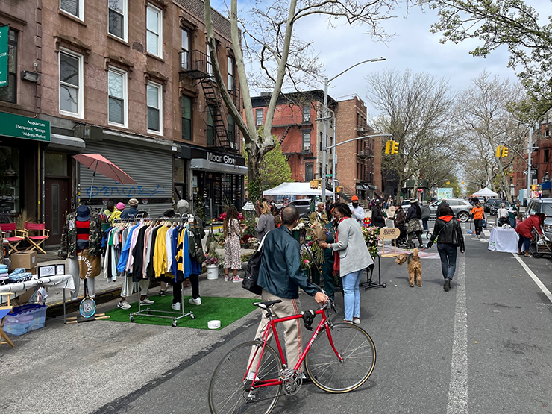
Open Streets
Close streets to vehicles, open streets to people
Benefits: - Public space in urban environments - Cultural programming - Special events - Community building - Cost effective
NYC DOT Open Streets

Slide 3
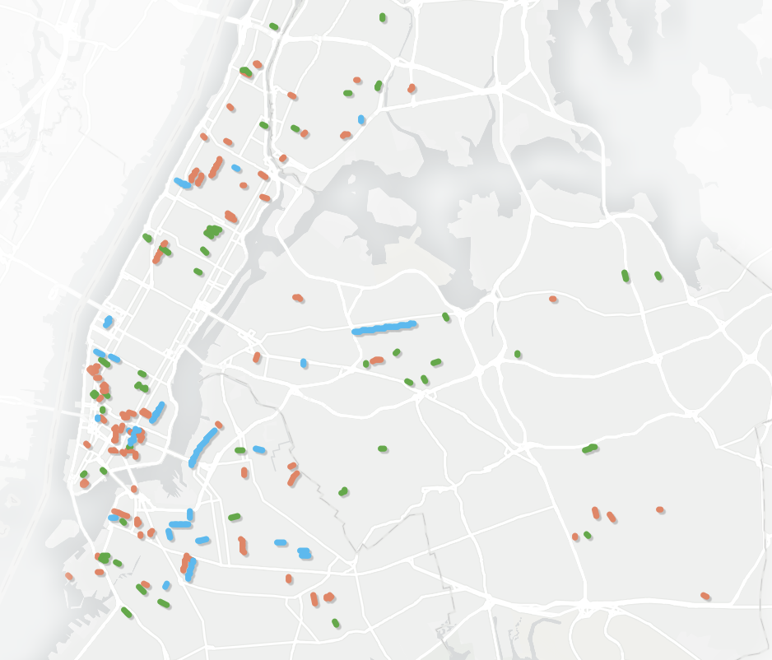
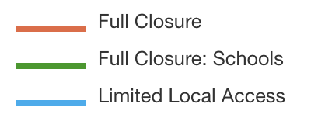
Open Streets Access
Often, open streets initiatives use an application process, biasing the streets to communities that know about it.
Question: Is there a more objective way to choose streets?
NYC DOT Open Streets

Slide 4
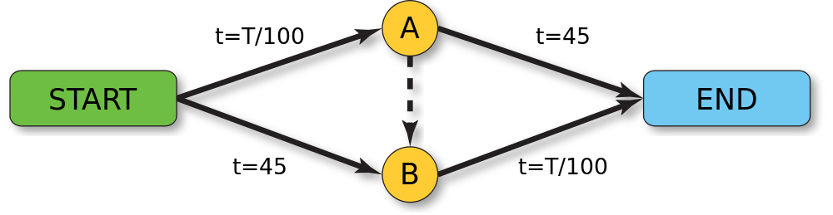
Braess’s Paradox
Removing edges in a network can sometimes reduce traffic.
Question: Can we choose streets which, when “opened”, reduce traffic?
Modeling: Empirical taxi trips. Easy to reroute cars when streets are “opened”.
Wikipedia

Slide 5
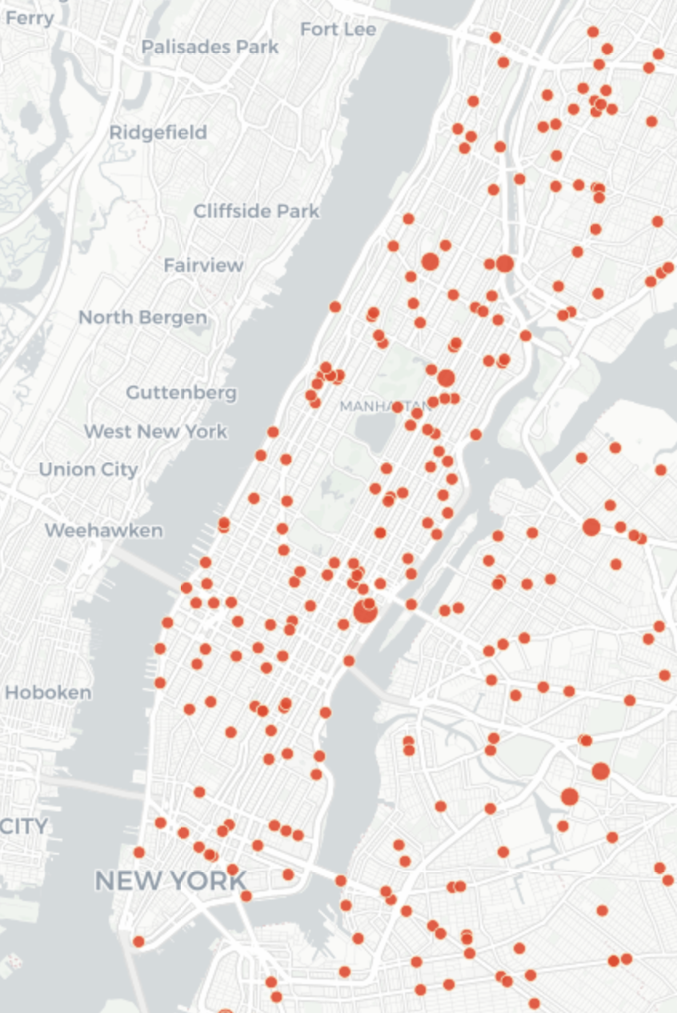
Collisions
Some intersections are more dangerous than others.
Question: Can we choose streets which, when “opened”, reduce collisions?
Modeling: Empirical collisions. Not obvious how collisions change when streets are “opened”.
Collision fatalities from 2013-2016 NYC Crash Mapper

Slide 6
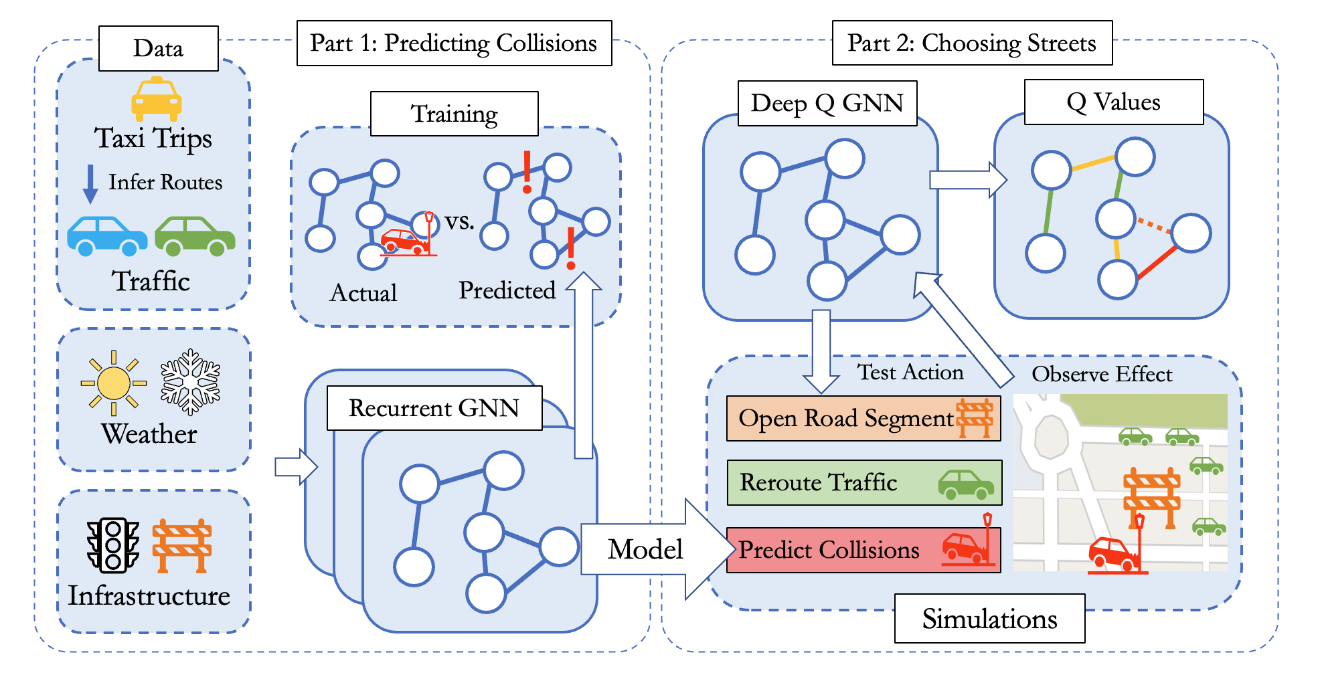
Our Approach

Slide 7
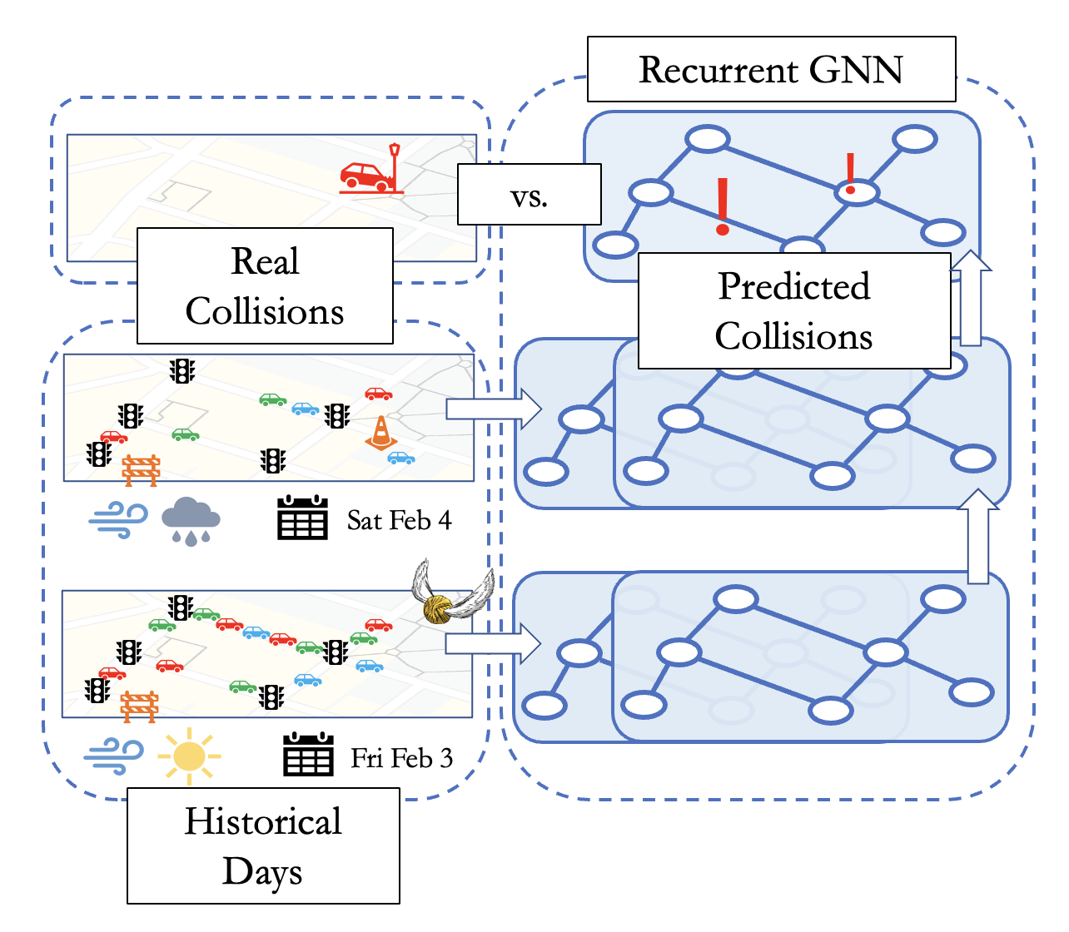
Part I: Predicting Collisions
Data Sources: - NYC Collisions - NYC LION Infrastructure - NOAA Daily Weather - NYC Taxi Trips
Recurrent Graph Neural Network: - Spatial dependency (e.g., speed changes) - Temporal dependency (e.g., wet roads)

Slide 8
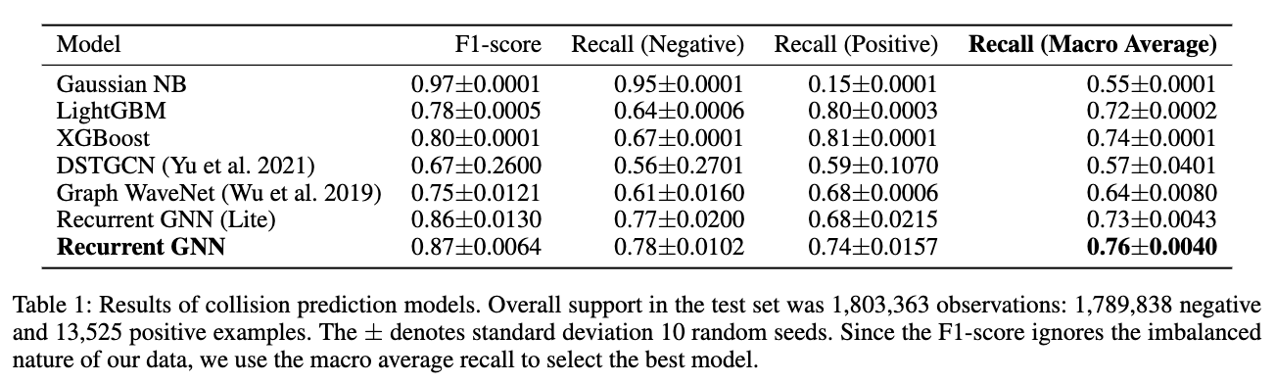
Part I: Model Performance
Goal: Performance on negative and positive instances

Slide 9
Part I: Feature Importance
Directed importance using the integrated gradients approach on the model with the highest macro recall.

Slide 10
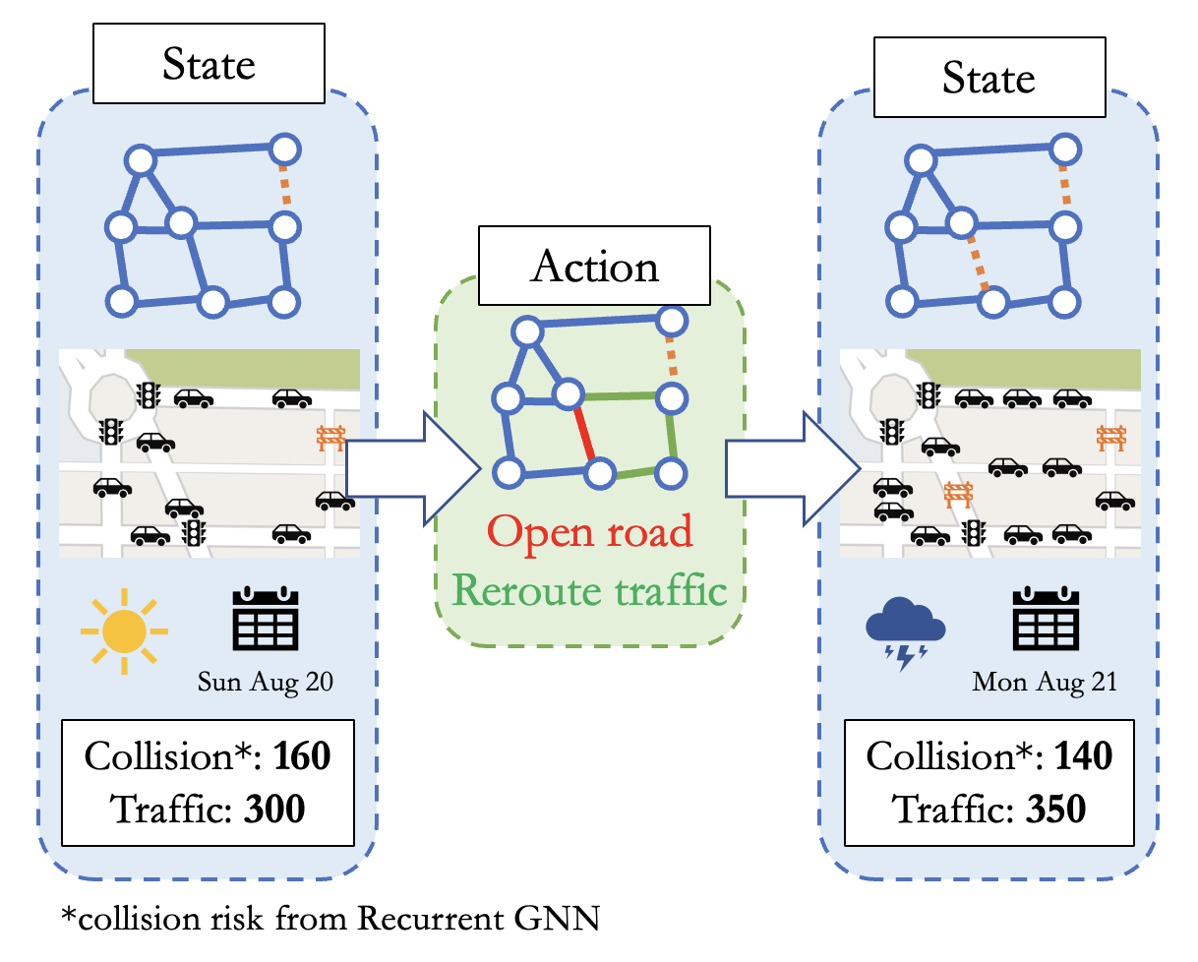
Part II: Reinforcement Learning
State: Real historical day with some streets opened.
Action: Open an additional street.
Reward: Change in normalized collision risk (from model) and traffic (car density).
Goal: Capture complicated dynamics of opening street.

Slide 11
Part II: Comparison
Experiment: Average improvement from 30 runs of opening street simulations (a simulation lasts a month or until an opened street disconnects the network).
Comparison: Q-value approach gives consistently high improvement whereas open streets and random closures are comparable.

Slide 12
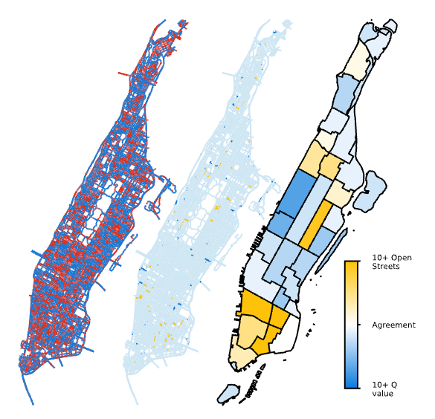
Part II: Which Streets?
Left: Q-values (blue is positive, red is negative)
Middle: 121 open streets (yellow) vs 121 q-value streets (blue)
Right: Difference in number of open vs q-value streets

Slide 13
Future Work
More work is needed before deployment!
Measuring traffic: We assume taxi data (and shortest path trips) are representative.
Near-collision events: Collisions are sparse but near-collision sensors are rare.
Other cities: GNN widely applicable but data sources and formats are not.
Interpretability: Our deep models are not interpretable.

Slide 14
Thank you!
All our code and data are available at github.com/rtealwitter/OpenStreets
Preprint is available at arxiv.org/abs/2312.07680
Please reach out with questions or comments to rtealwitter@nyu.edu

